Slide 1
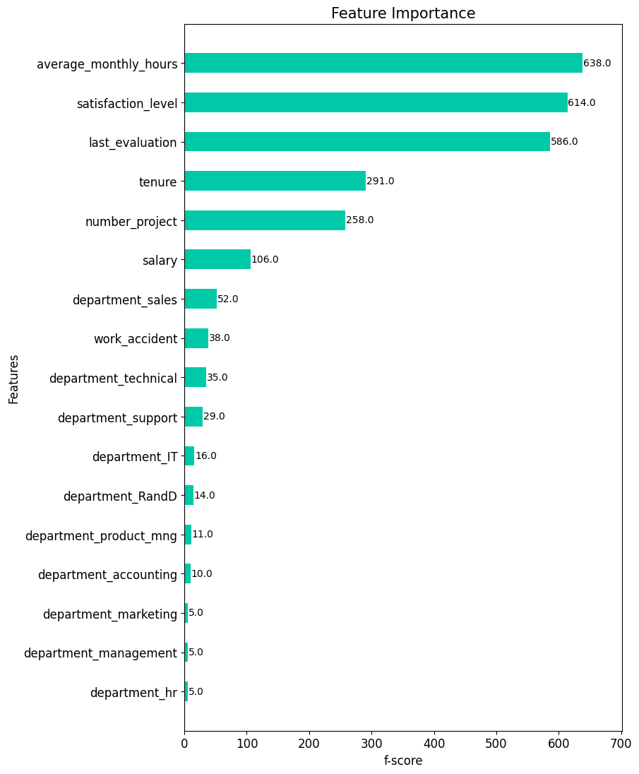
Salifort Motors
Employee Retention Project
Salifort Motors is experiencing a high level of leaving employees. The company wants to improve retention by answering the following question: What’s likely to make the employee leave the company?
The variable we are predicting is categorical, indicating whether or not an employee will leave. We have build three different models:
Logistic Regression (LR)
Random Forest Classifier (RF)
XGBoost Classifier (XGB)
The XGB and RF outperforms LR with XGB being computationally fastest.
The model predicts whether an employee will leave and identify which factors are most influential. The model insights can help HR in making decisions to improve retention.
Barplot showing the most relevant factors for predicting if employees will leave.
The EDA showed that employees are overworked, and this is correlated with leaving. Retention efforts should focus on managing problems with overwork. The following recommendations can be considered:
Engage in dialogue with the employees about overworking. Try to understand the working culture and investigate if steps can be taken do decrease unnecessary overwork.
Cap number of projects employees can take part in. Consider capping the number of working hours or engage in dialogue with employees that reach a specific number of hours (e.g. above 160/180).
Investigate why high evaluations scores are strongly correlated with working many hours. High evaluations should not be reserved for employees working the most.
Set-up regular check-ins where teams can prioritize their tasks in order to improve time management avoid overworking on tasks that can be completed at another time.

